Slide 1
Build a Serverless Web Application
with AWS Lambda, Amazon API Gateway, Amazon S3, Amazon DynamoDB, and Amazon Cognito

Slide 2
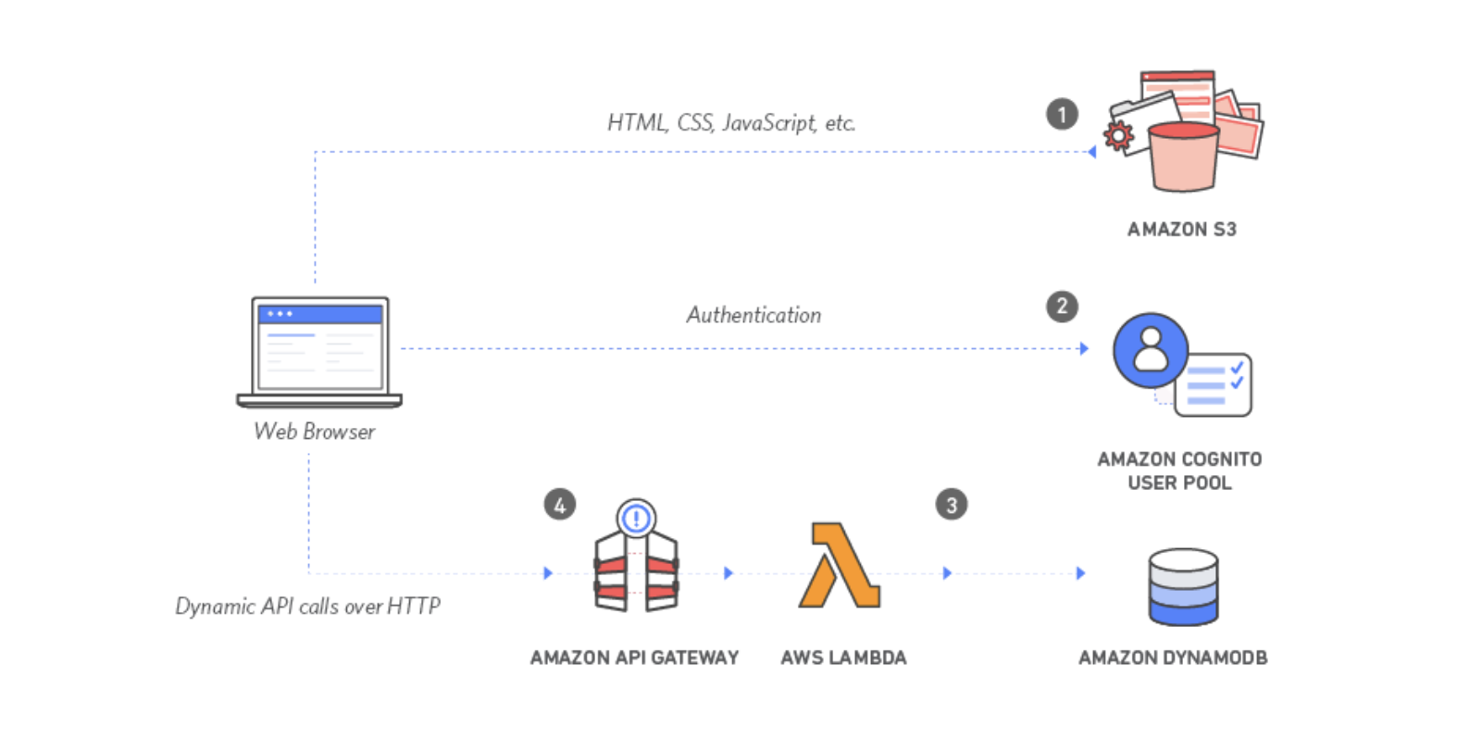

Slide 3
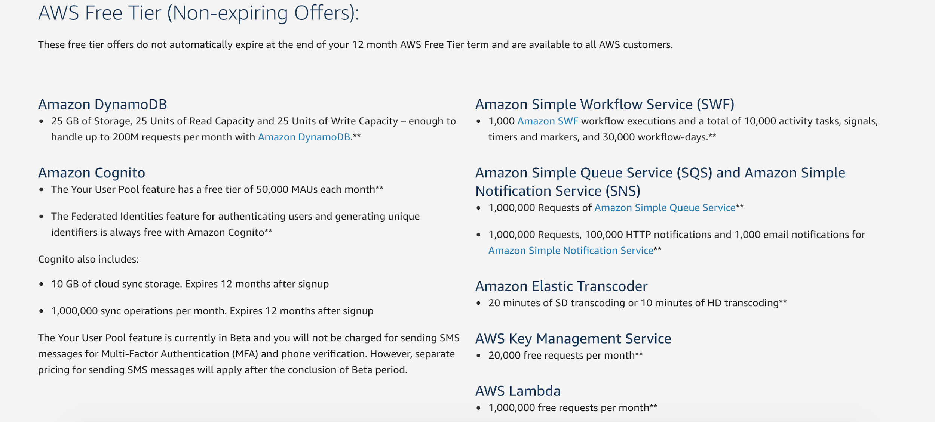
https://aws.amazon.com/free/

Slide 4
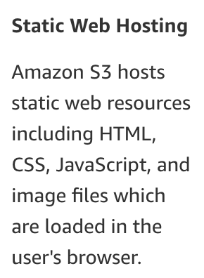

Slide 5
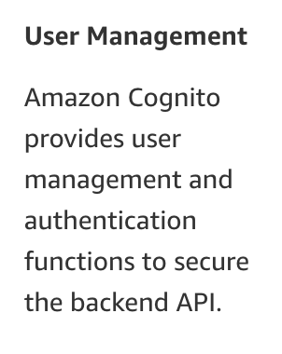

Slide 6
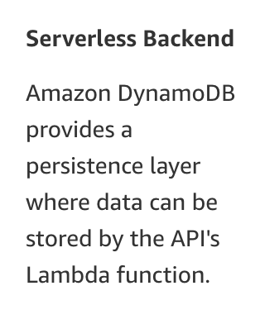

Slide 7
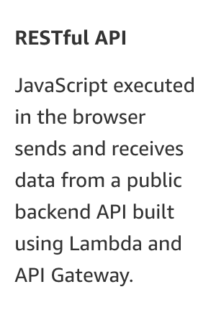

Slide 8
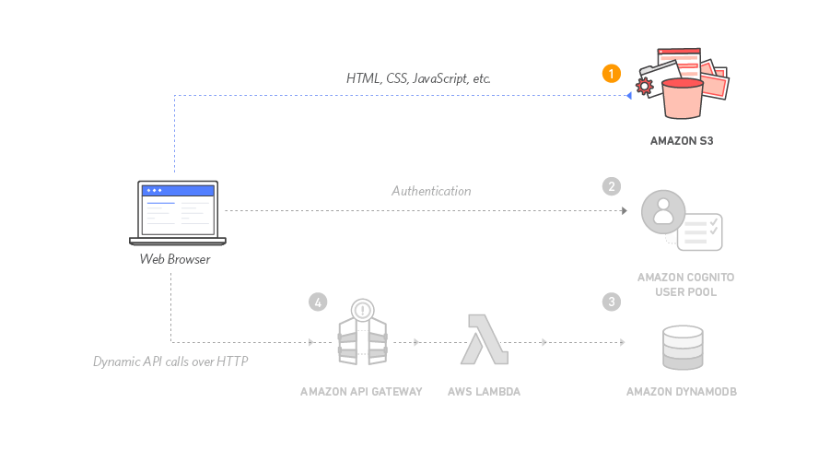
Static Web Hosting
configure Amazon Simple Storage Service (S3) to host the static resources for your web application.

Slide 9
Static Web Hosting
To skip
https://console.aws.amazon.com/cloudformation/home?region=us-east-1#/stacks/new?stackName=wildrydes-webapp-1&templateURL=https://s3.amazonaws.com/wildrydes-us-east-1/WebApplication/1_StaticWebHosting/webapp-static-hosting.yaml

Slide 10
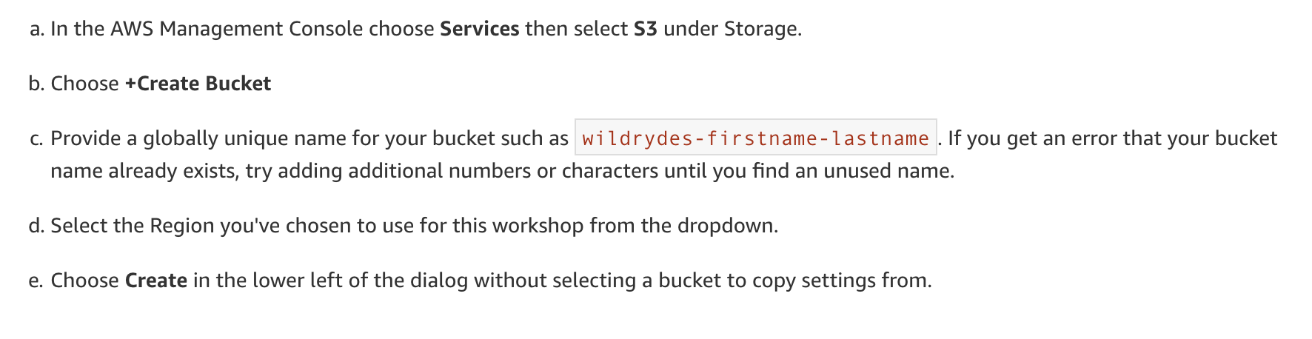
Create an S3 Bucket

Slide 11
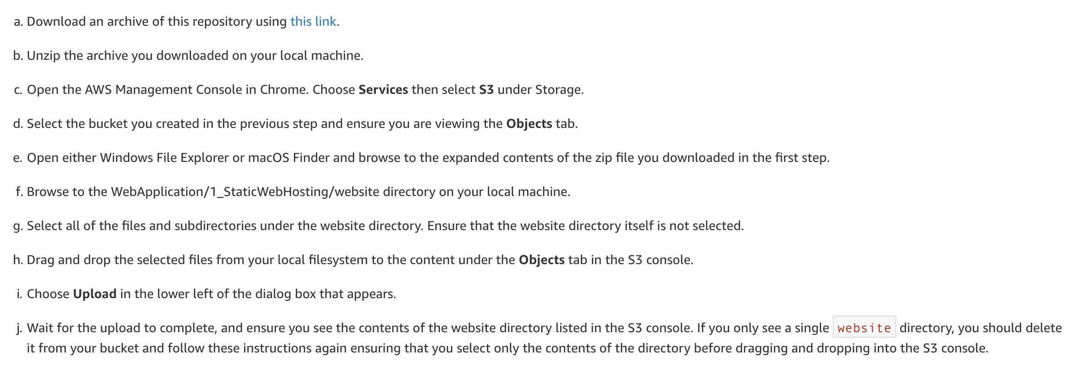
Upload Content

Slide 12
Upload Content

Slide 13
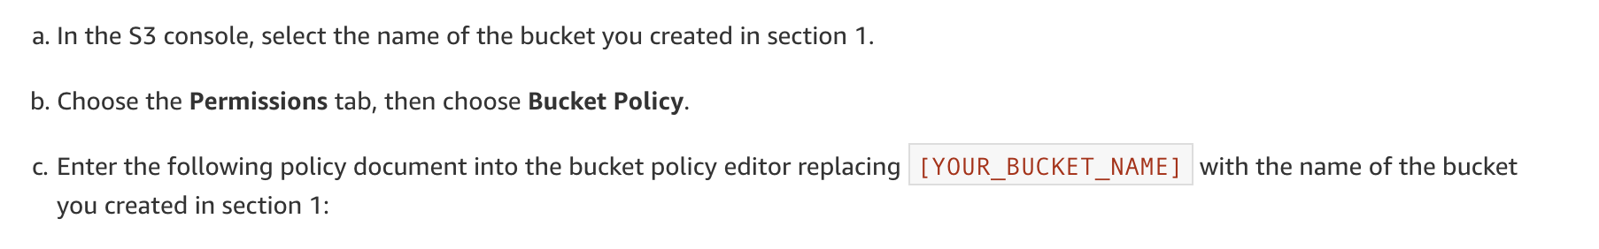
Add a Bucket Policy to Allow Public Reads

Slide 14
Add a Bucket Policy to Allow Public Reads
{
"Version": "2012-10-17",
"Statement": [
{
"Effect": "Allow",
"Principal": "*",
"Action": "s3:GetObject",
"Resource": "arn:aws:s3:::[YOUR_BUCKET_NAME]/*"
}
]
}

Slide 15
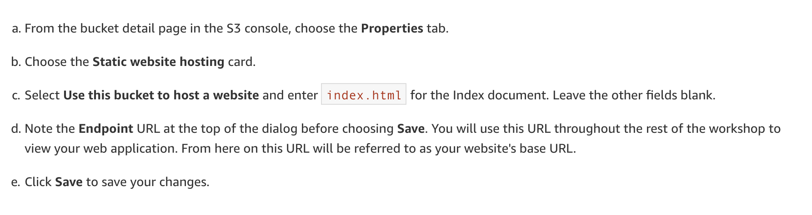
Enable Website Hosting

Slide 16
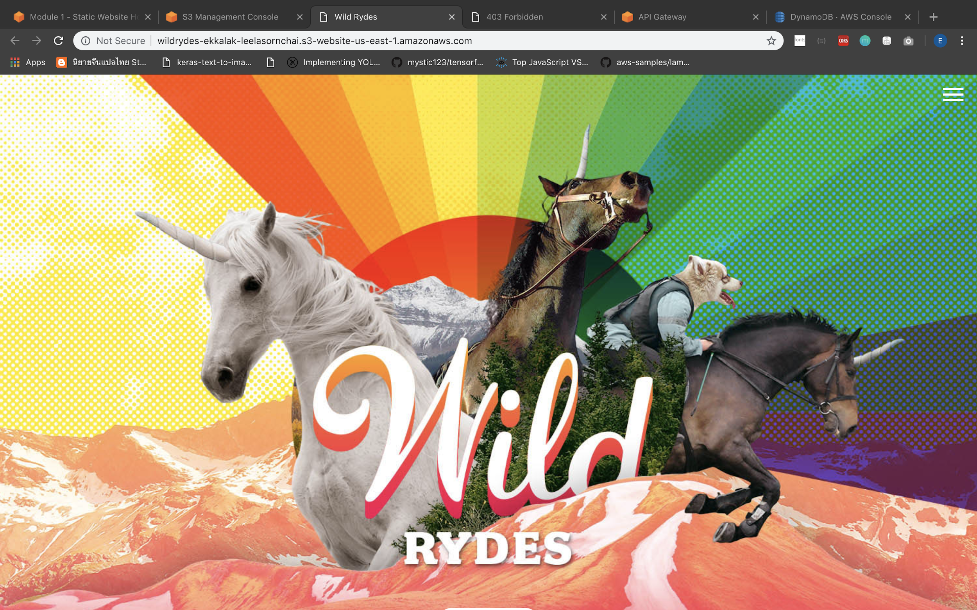

Slide 17
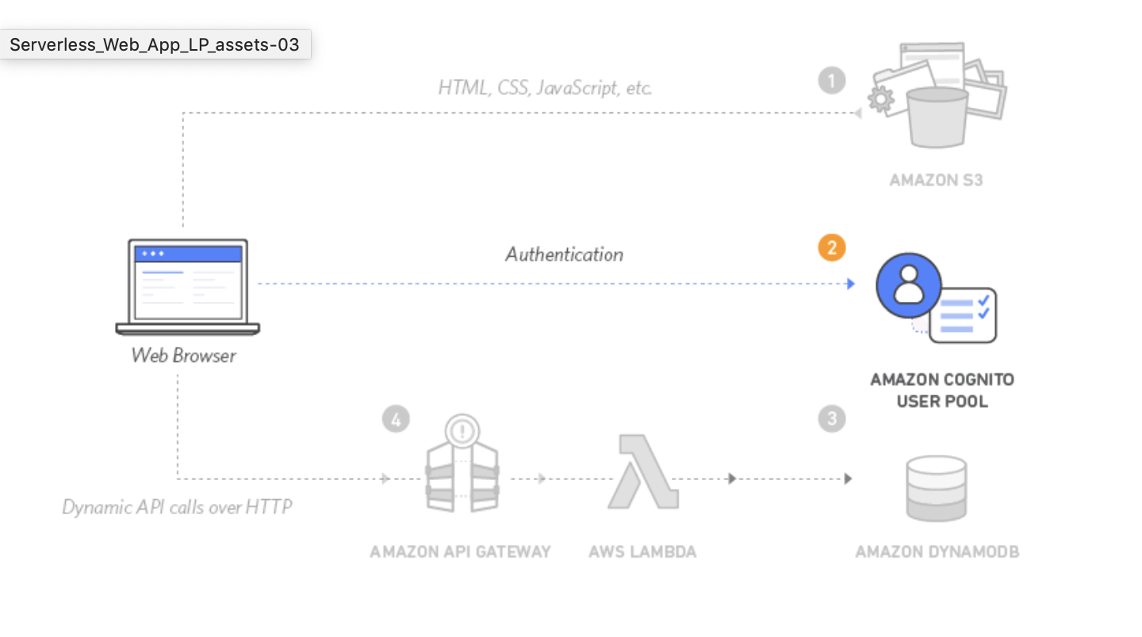
User Management
create an Amazon Cognito user pool to manage your users' accounts. You'll deploy pages that enable customers to register as a new user, verify their email address, and sign into the site.

Slide 18
User Management
To skip
https://console.aws.amazon.com/cloudformation/home?region=us-east-1#/stacks/new?stackName=wildrydes-webapp-2&templateURL=https://s3.amazonaws.com/wildrydes-us-east-1/WebApplication/2_UserManagement/user-management.yaml

Slide 19
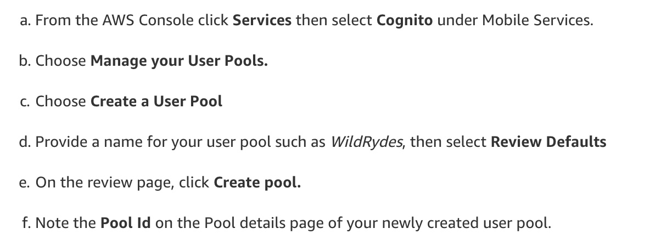
Create an Amazon Cognito User Pool

Slide 20
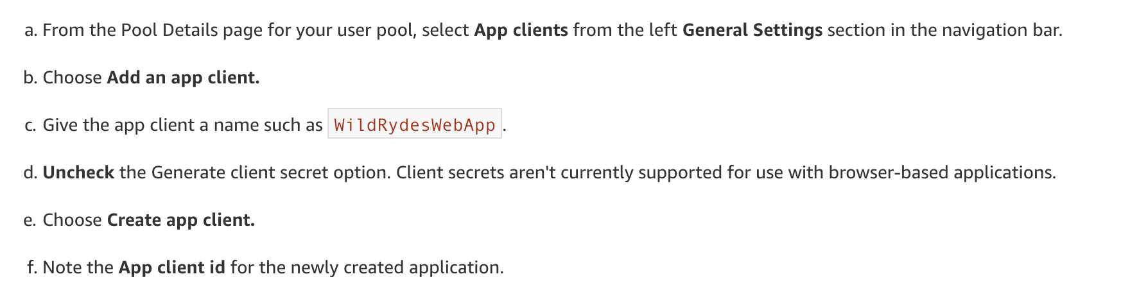
Add an App to Your User Pool

Slide 21
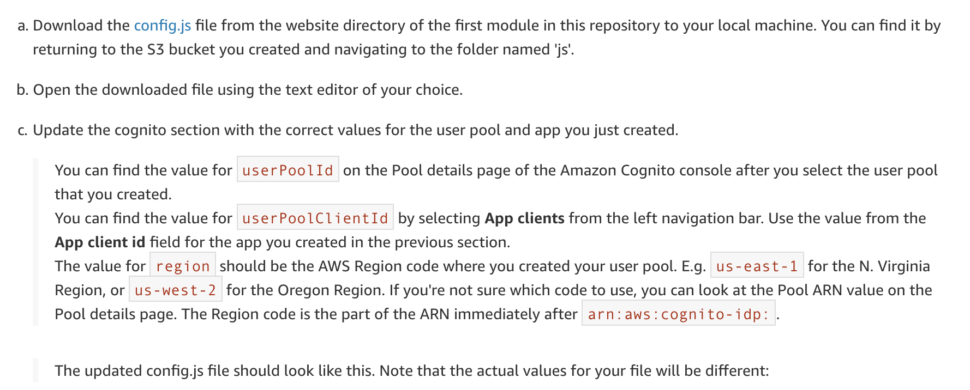
Update the config.js File in Your Website Bucket

Slide 22
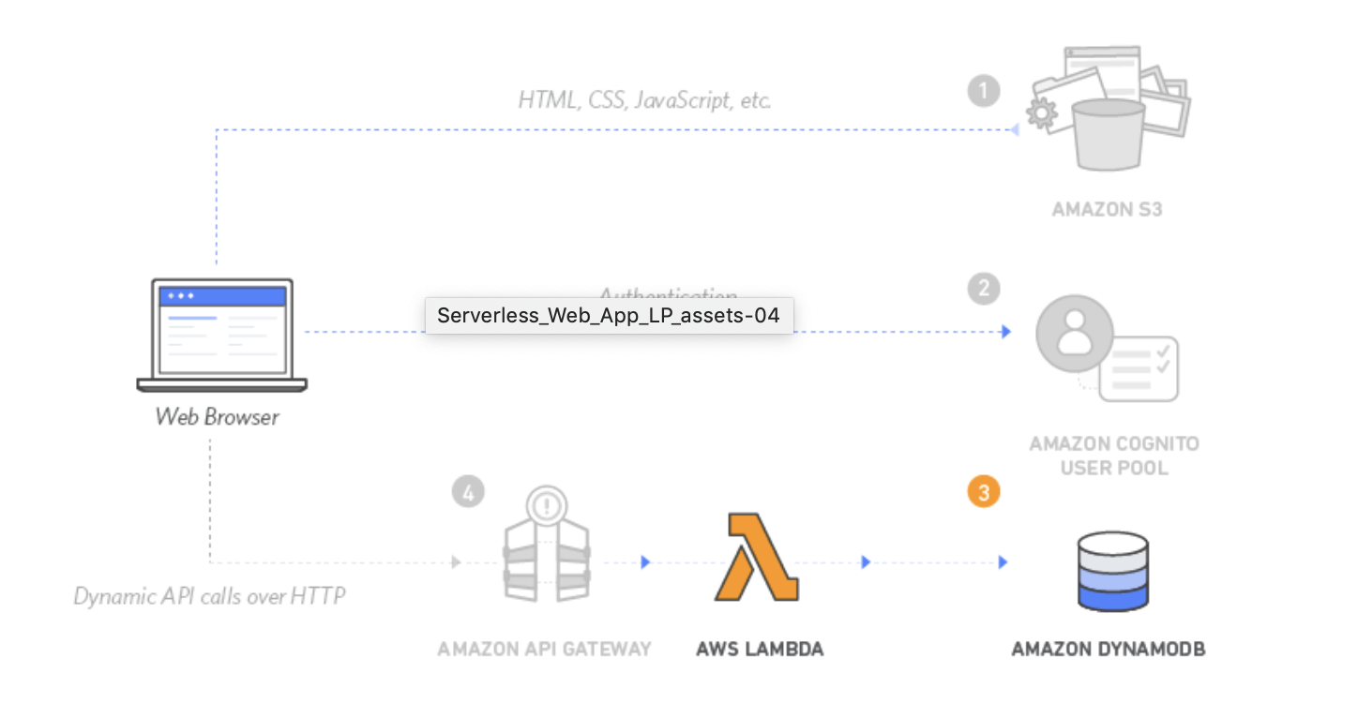
Serverless Service Backend
use AWS Lambda and Amazon DynamoDB to build a backend process for handling requests for your web application

Slide 23
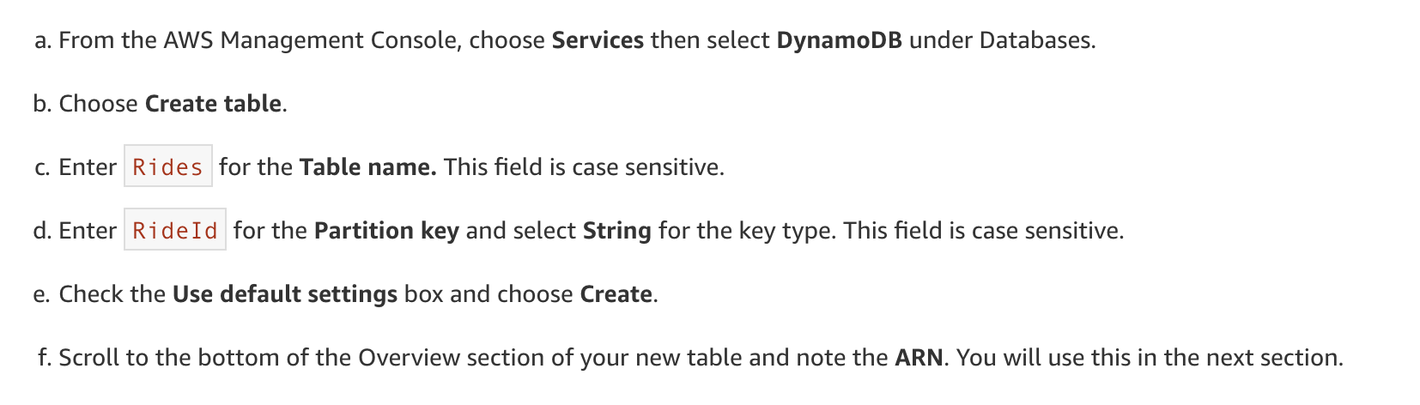
Create an Amazon DynamoDB Table

Slide 24
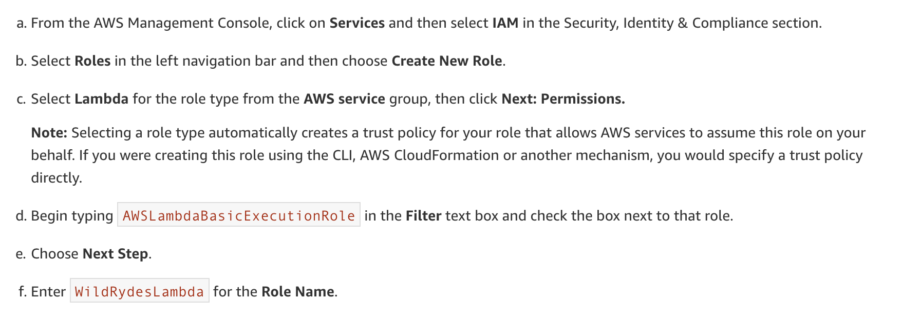
Create an IAM Role for Your Lambda function

Slide 25
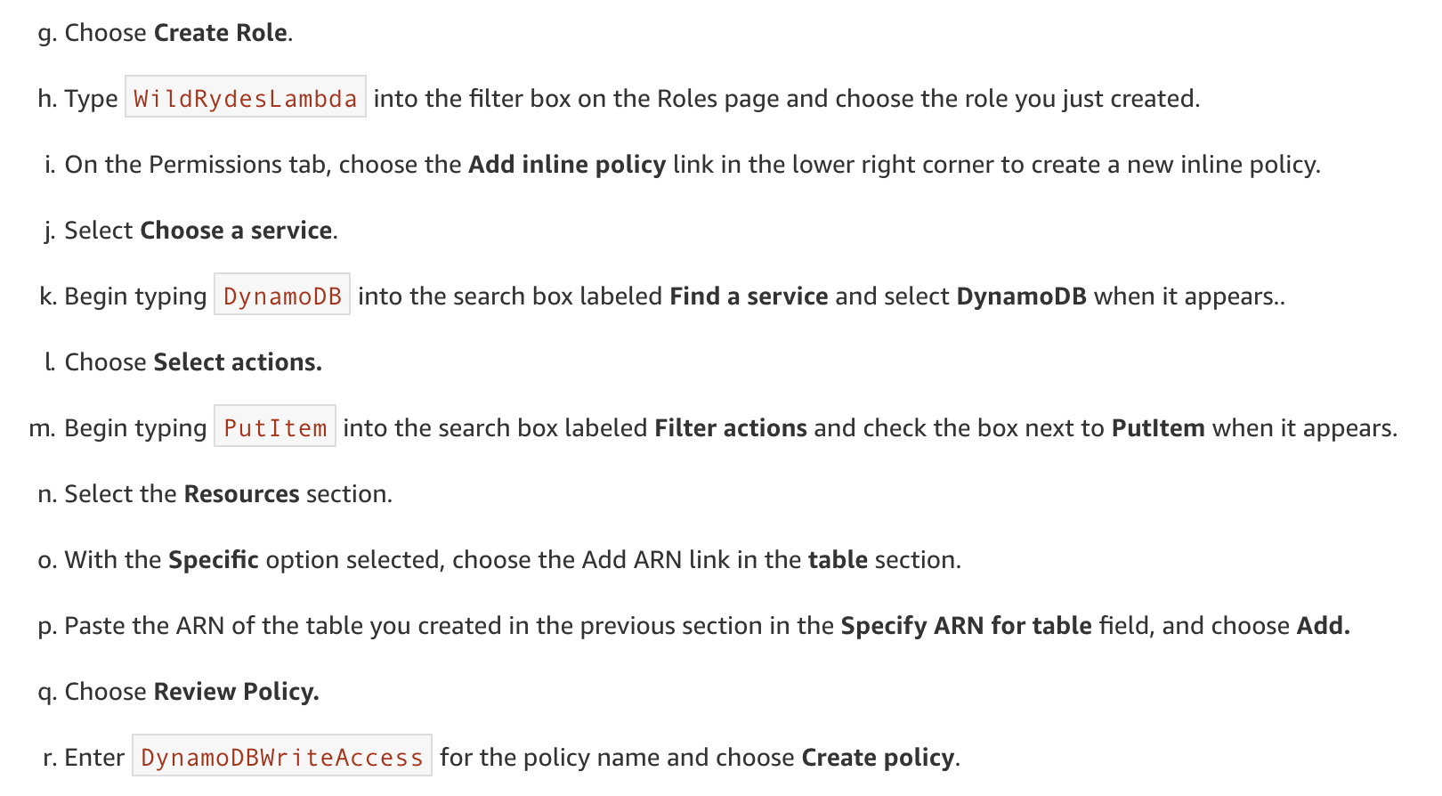
Create an IAM Role for Your Lambda function

Slide 26
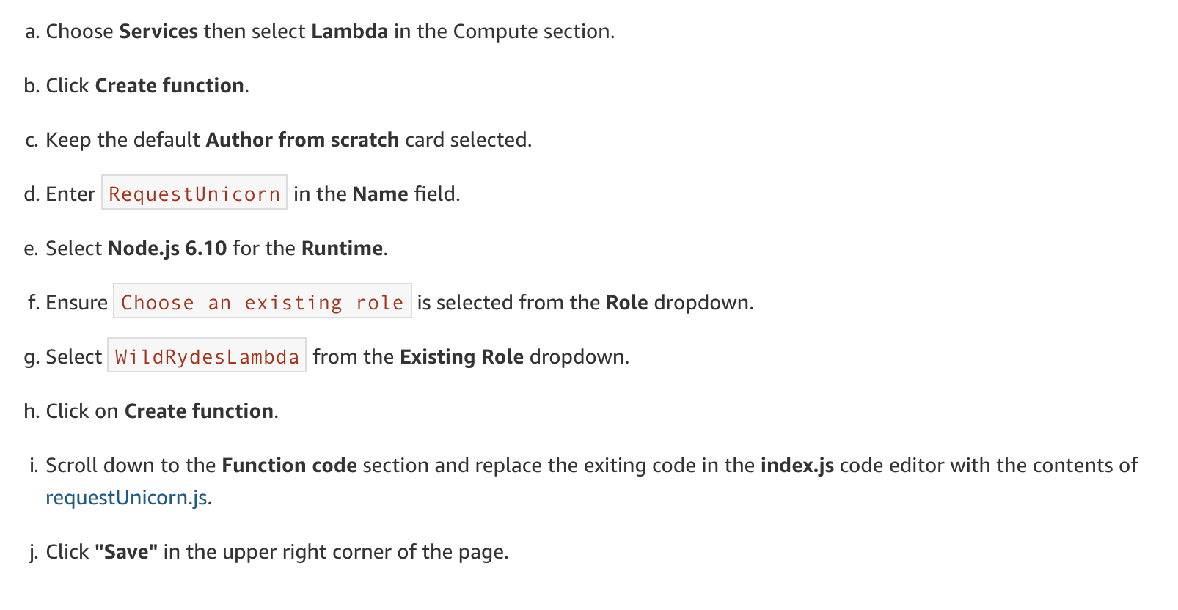
Create a Lambda Function for Handling Requests

Slide 27
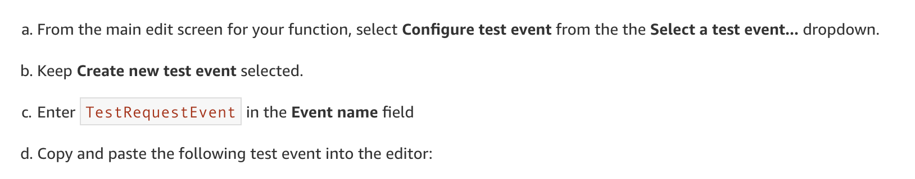
Validate Your Implementation

Slide 28
Validate Your Implementation
{
"path": "/ride",
"httpMethod": "POST",
"headers": {
"Accept": "*/*",
"Authorization": "eyJraWQiOiJLTzRVMWZs",
"content-type": "application/json; charset=UTF-8"
},
"queryStringParameters": null,
"pathParameters": null,
"requestContext": {
"authorizer": {
"claims": {
"cognito:username": "the_username"
}
}
},
"body": "{\"PickupLocation\":{\"Latitude\":47.6174755835663,\"Longitude\":-122.28837066650185}}"
}

Slide 29
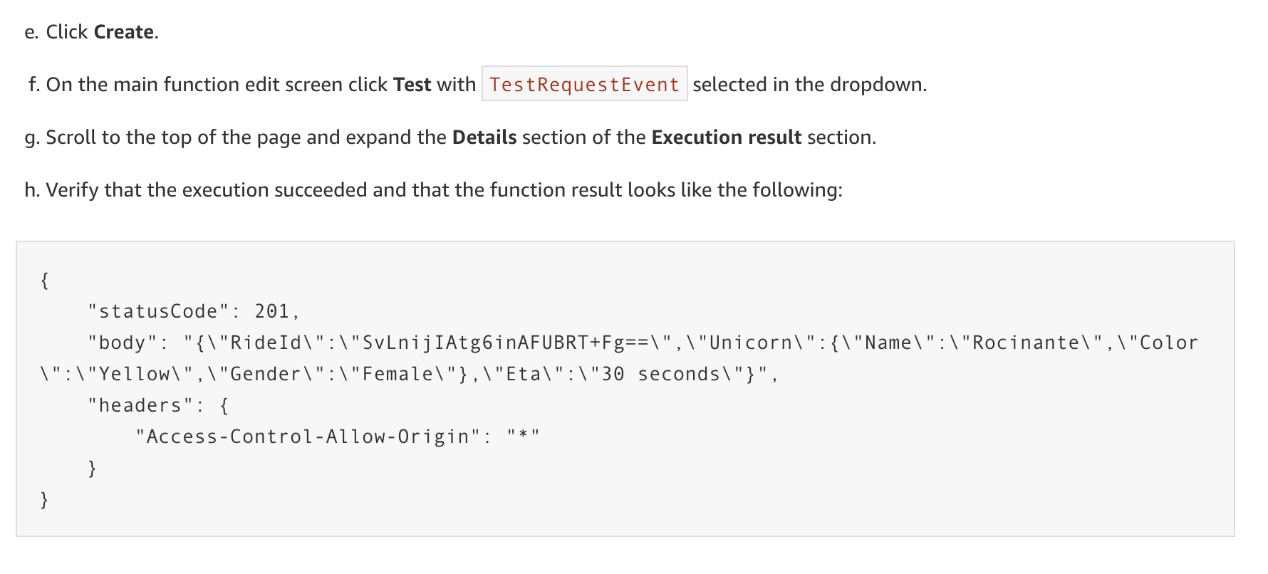
Validate Your Implementation

Slide 30
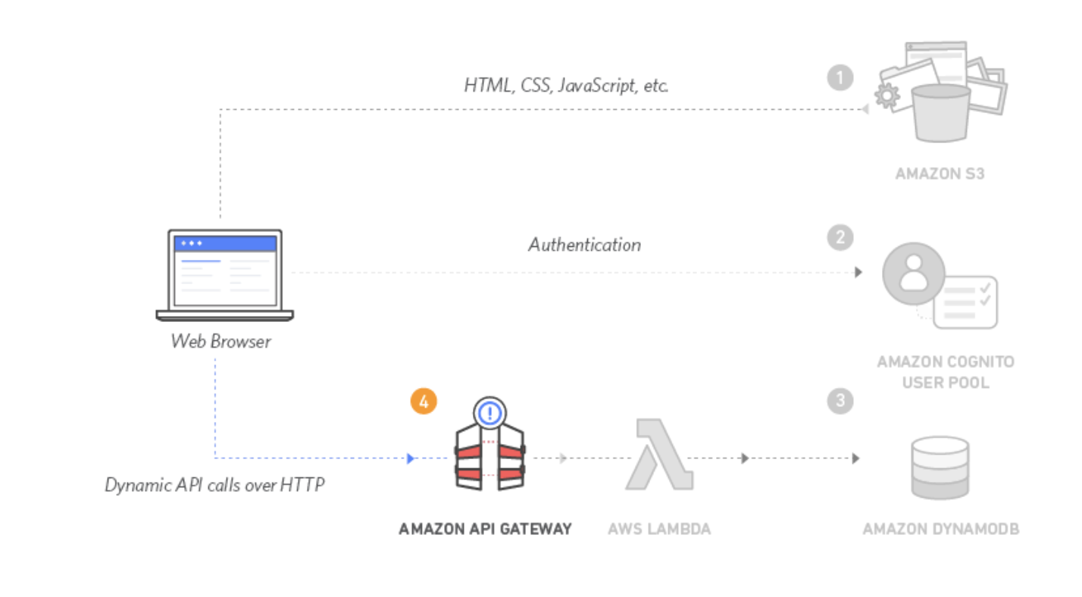
Deploy a RESTful API
use Amazon API Gateway to expose the Lambda function you built in the previous module as a RESTful API

Slide 31
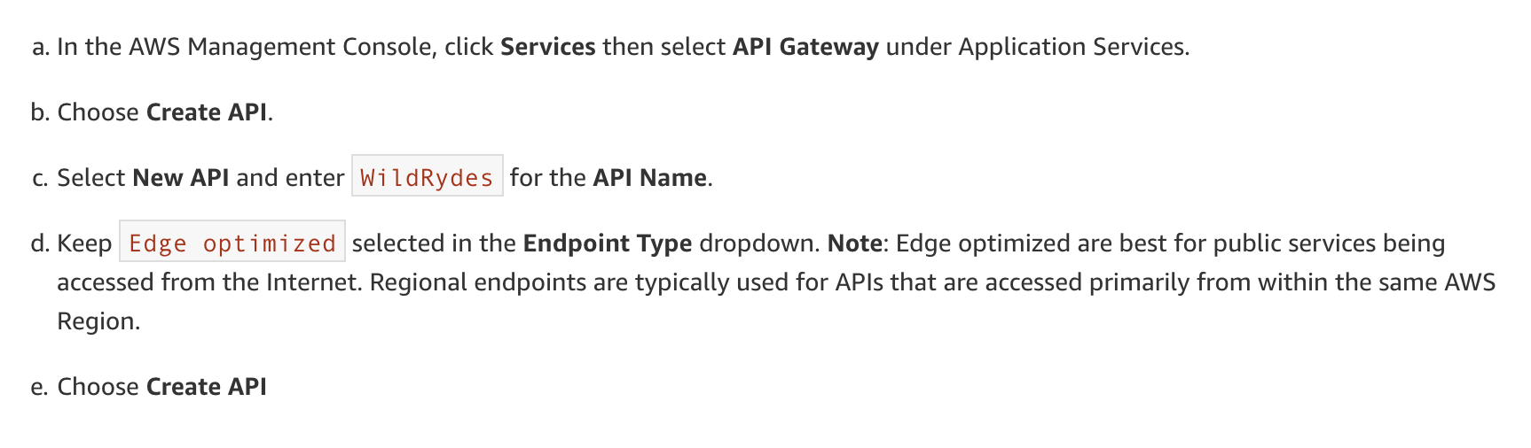
Create a New REST API

Slide 32
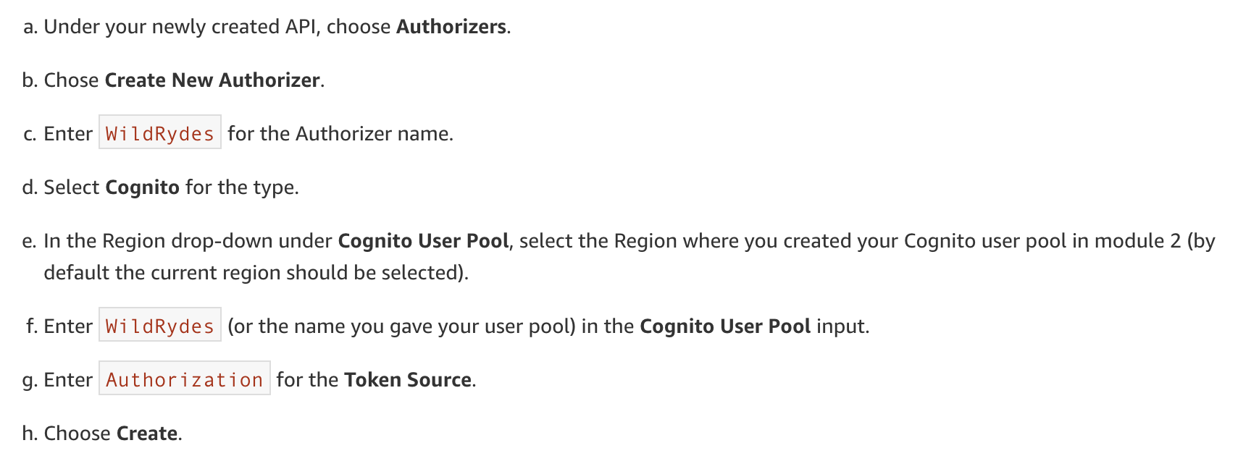
Create a Cognito User Pools Authorizer

Slide 33
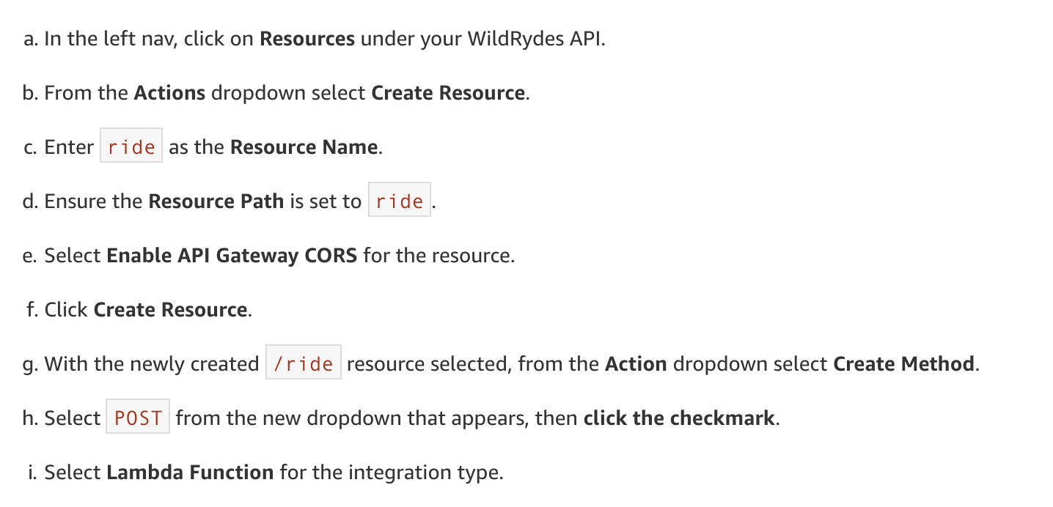
Create a new resource and method

Slide 34
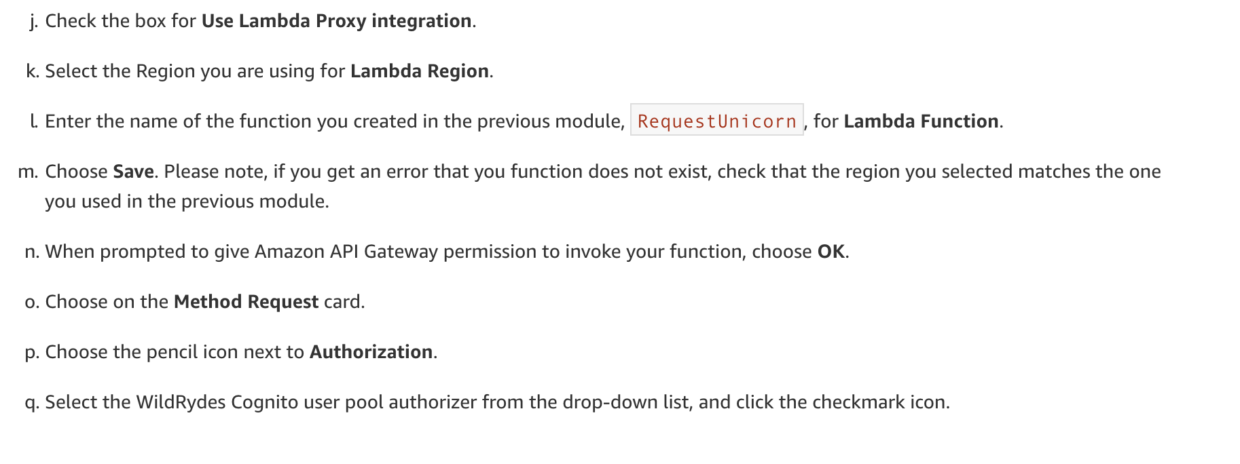
Create a new resource and method

Slide 35
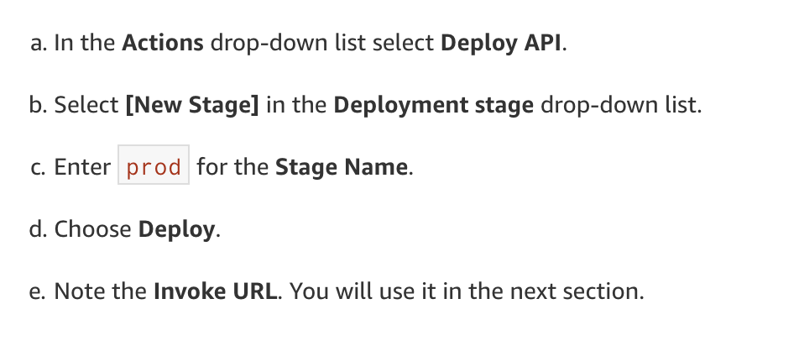
Deploy Your API

Slide 36
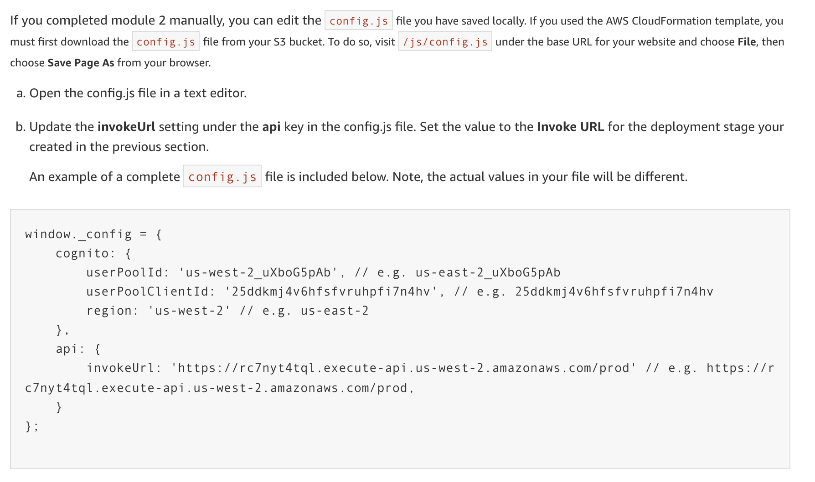
Update the Website Config

Slide 37
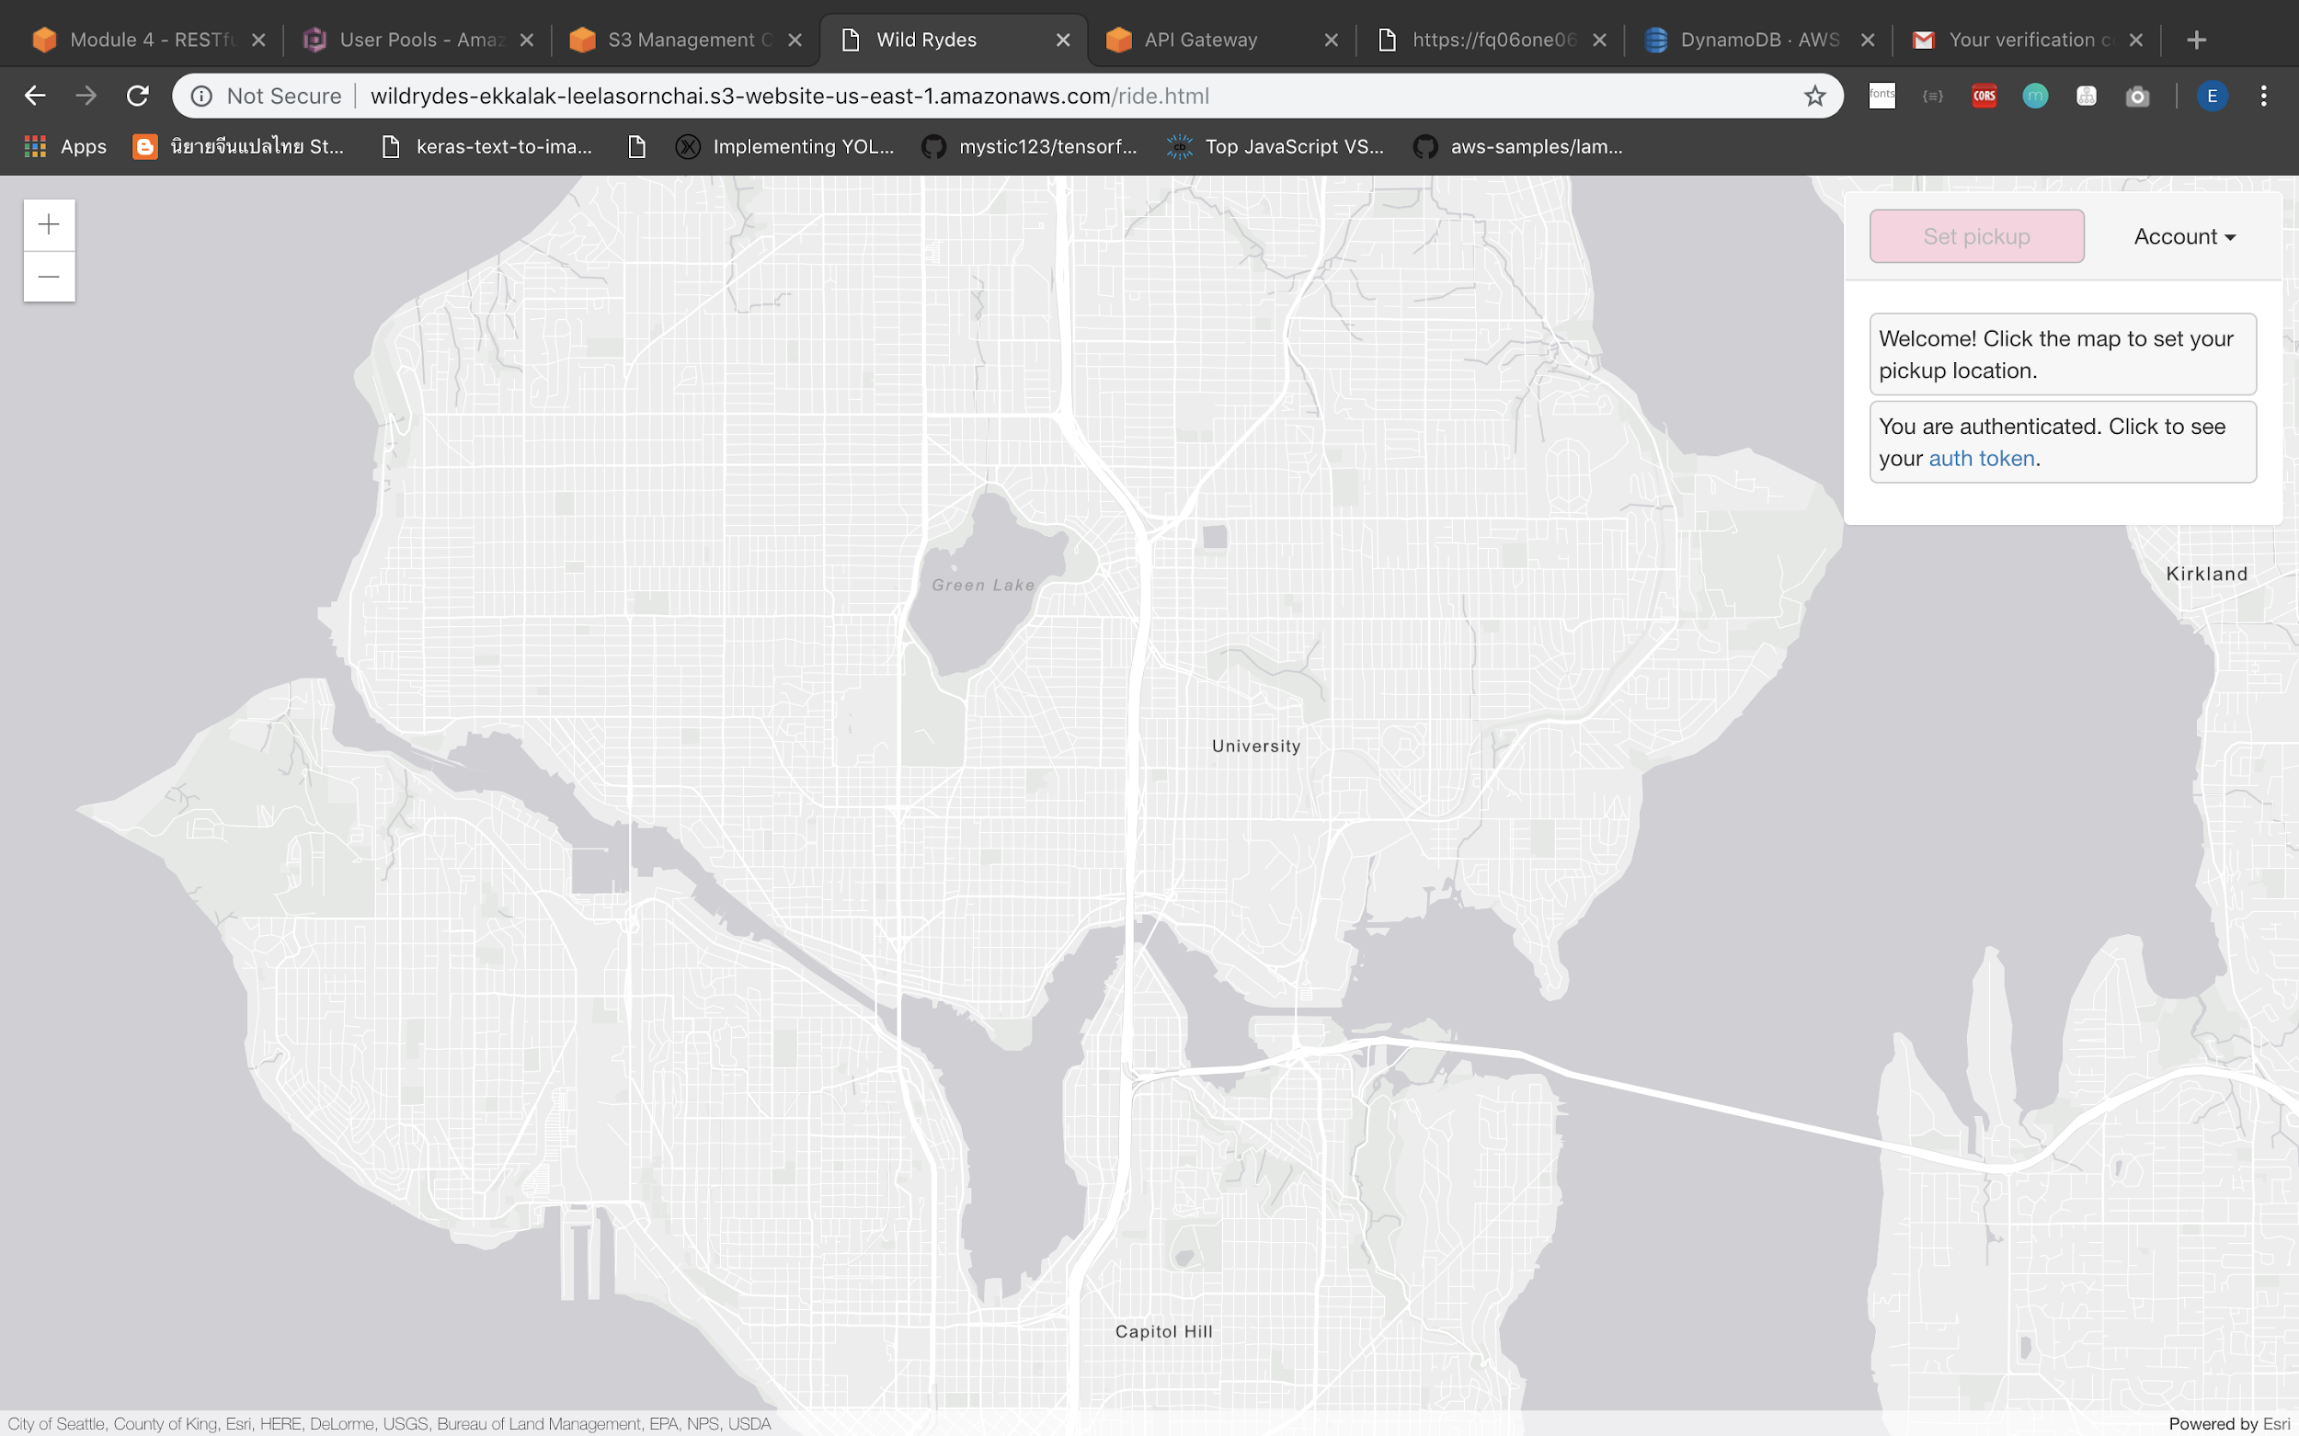
Validate your implementation
/ride.html

Slide 38
Resource Cleanup
you will go through the steps to terminate all the resources you created throughout this tutorial

Slide 39
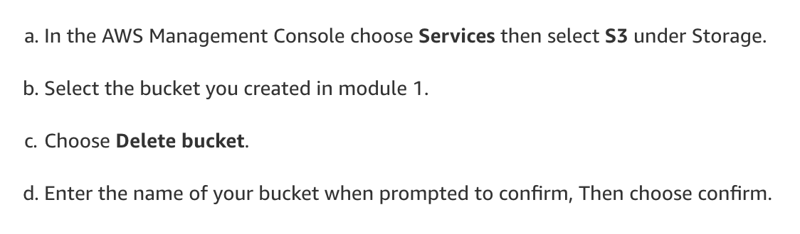
Delete your Amazon S3 bucket

Slide 40
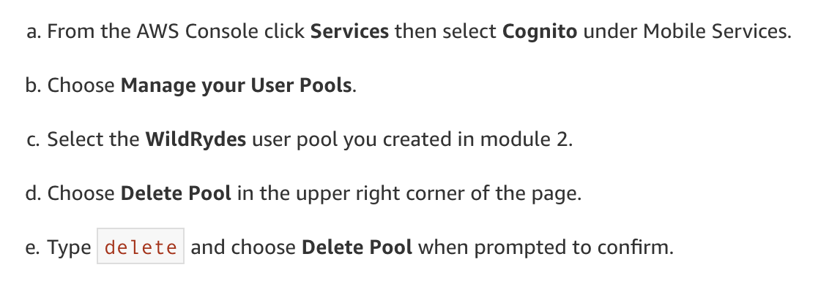
Delete your Amazon Cognito user pool

Slide 41
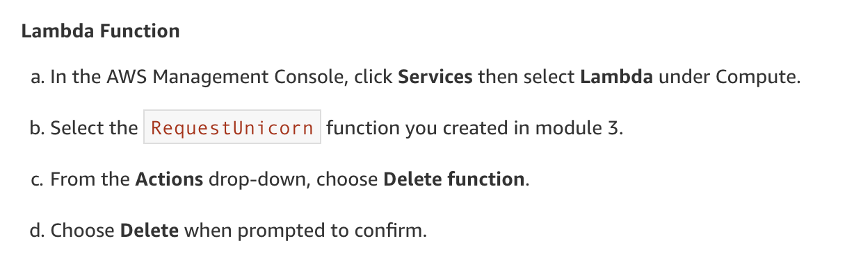
Delete your serverless backend

Slide 42
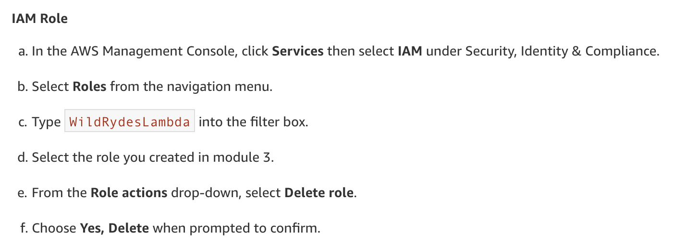
Delete your serverless backend

Slide 43
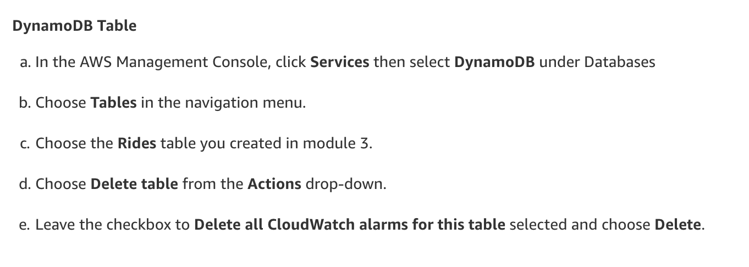
Delete your serverless backend

Slide 44
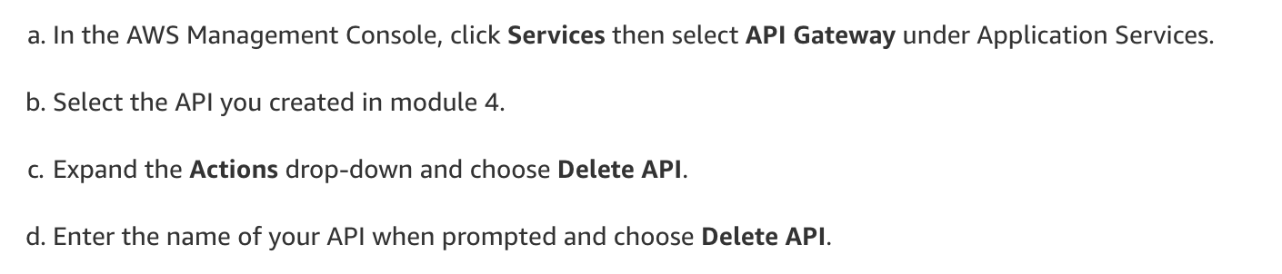
Delete your REST API

Slide 45
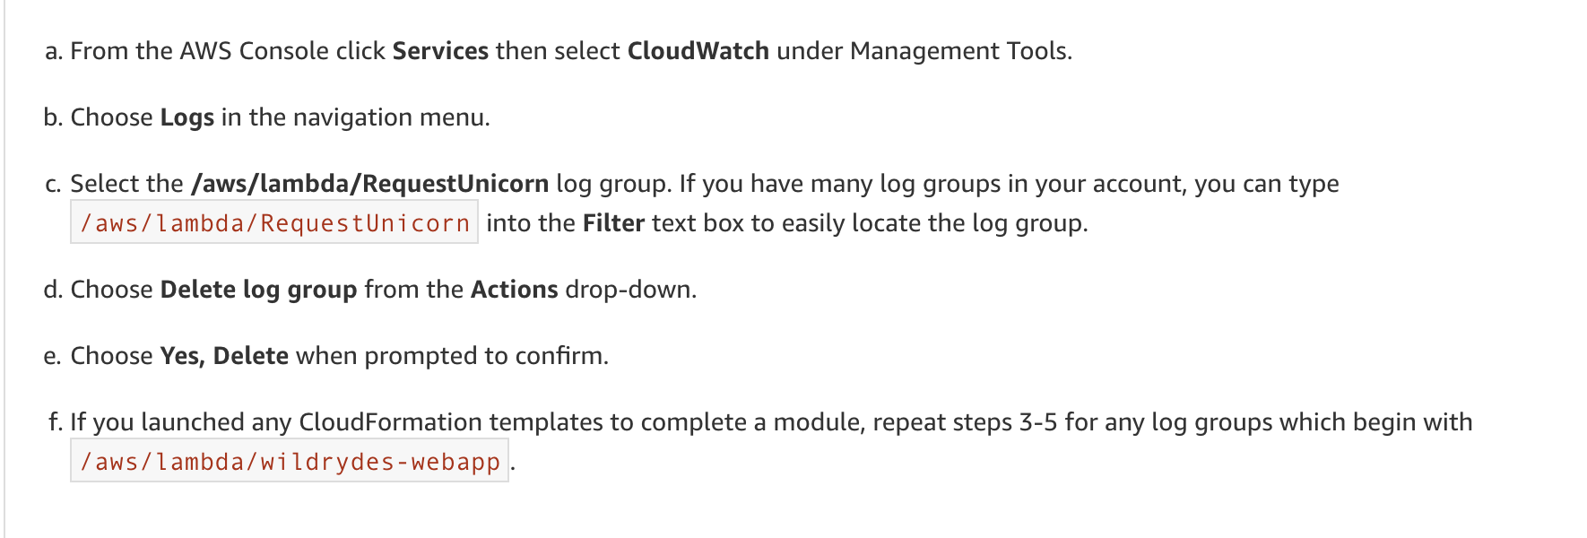
Delete your CloudWatch Log

Slide 46
More Architecture

Slide 47
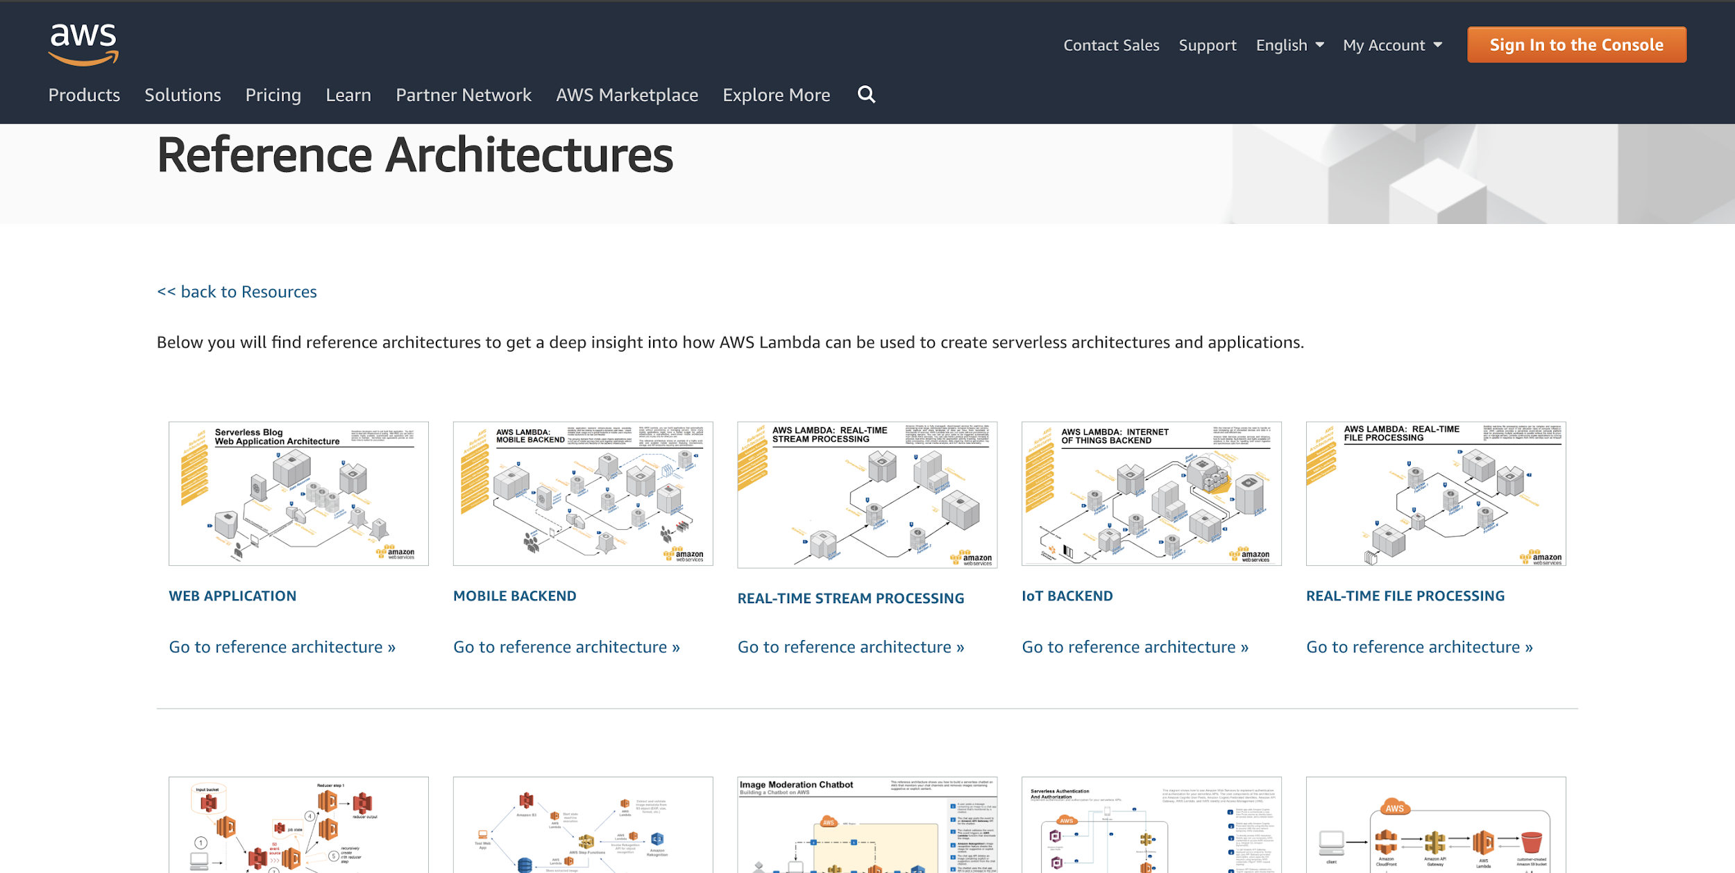
https://aws.amazon.com/lambda/resources/reference-architectures/

Slide 48
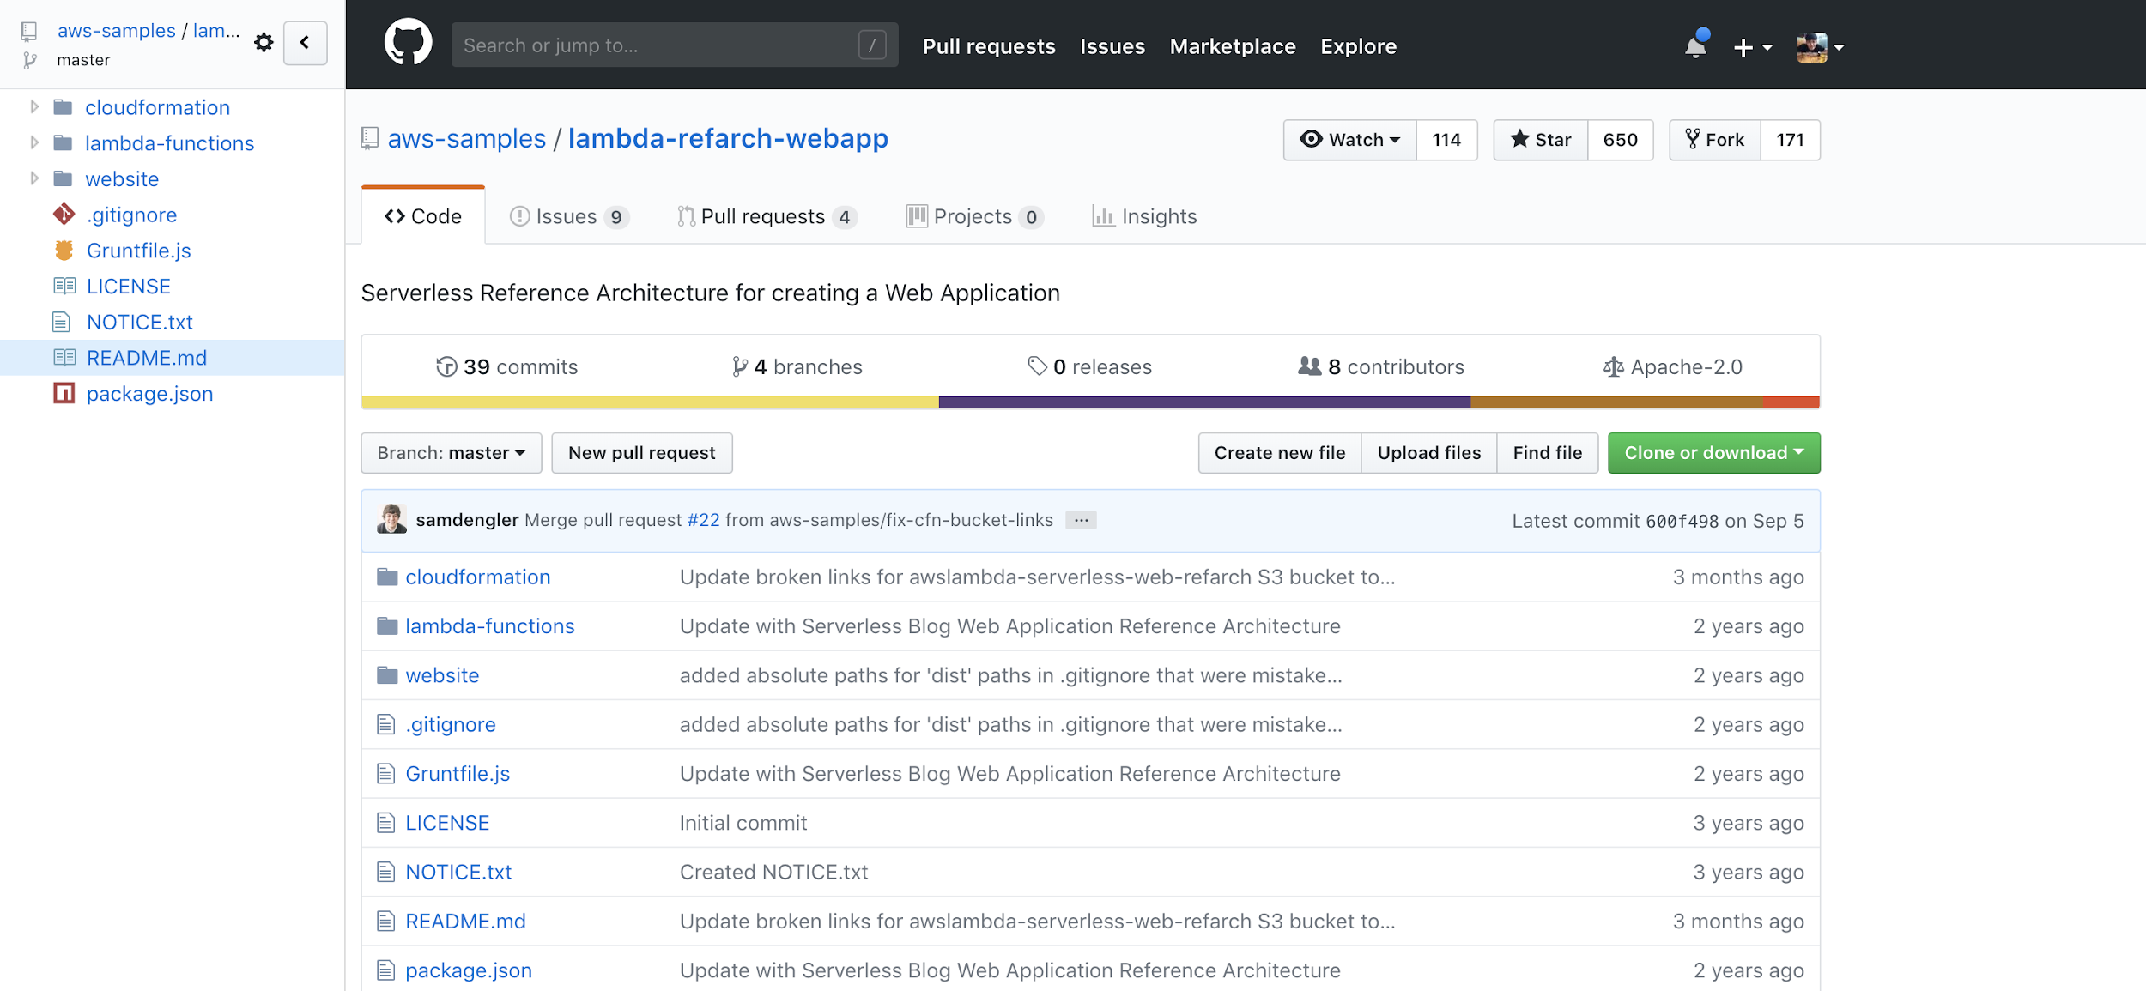

Slide 49
